Slide 1
Heart Disease Analysis
Using Power BI

Slide 2
Overview
Clean
Transform
Analyze
visualize data.

Slide 3
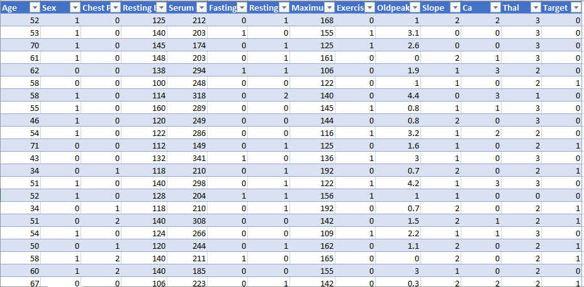
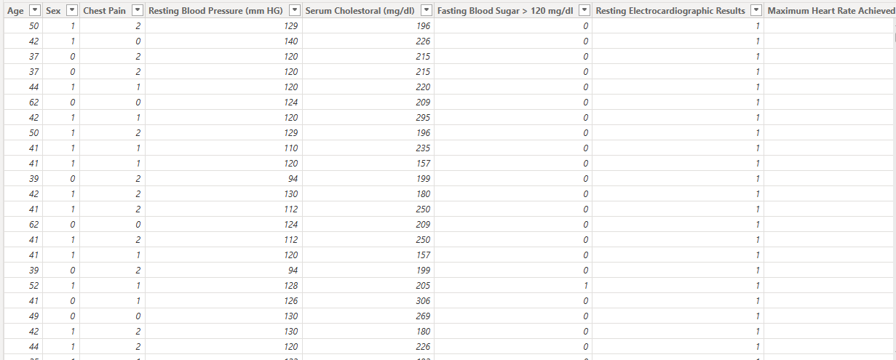
Cleaning Process

Slide 4
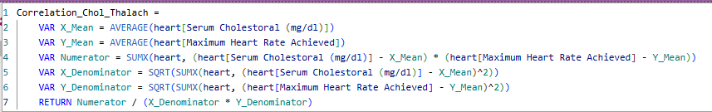

Calculations

Slide 5
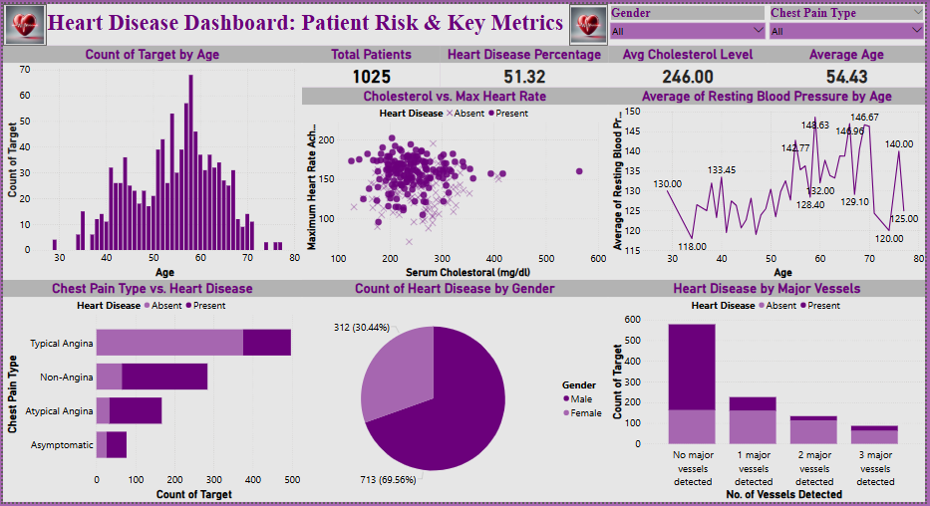
Dashboard Overview

Slide 6
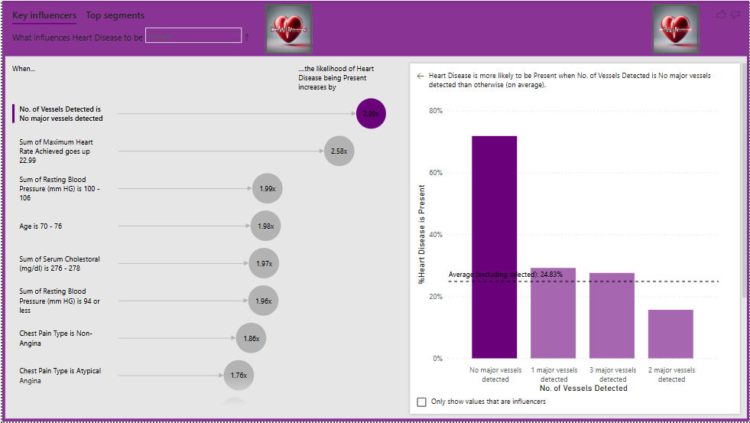
Key Insights

Slide 7
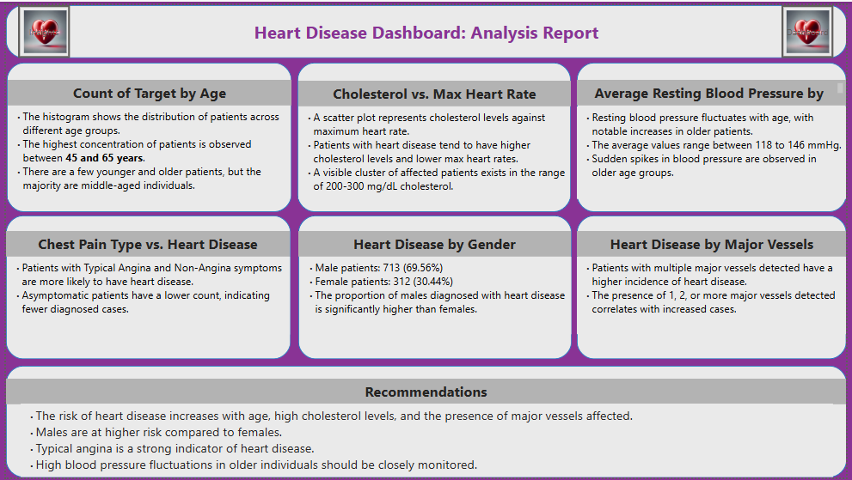
Recommendations

Slide 8


